Slide 1
Identification of Spear phishing attacks using Machine Learning

Slide 2
ABSTRACT
Phishing is a persistent and serious security threat that affects individuals and brands.
Spear phishing, a highly targeted form of phishing, relies on extensive information to maximize success.
Proposed solution: Develop a machine learning model using SVM, Decision Trees, LSTM , Naive Bayes, and logistic regression to classify emails as legitimate or phishing.
Implement a user-friendly GUI for easy interaction with the model.
Model evaluates emails features and provides a probability score to identify phishing attempts.

Slide 3
PROPOSED WORK
We propose a model that focuses on email security in the face of the increasing threat of cybercrime and especially the threat of phishing and spear phishing attacks.
Machine learning algorithms are used in this model to classify emails as legitimate or phishing, including SVM, Decision Tree, LSTM , Naive Bayes, and logistic regression.
The system analyzes email patterns and features to provide users with a user-friendly Graphical User Interface (GUI) for determining the email is legitimate or not.
Based on the model's advanced evaluation, an organization and individuals can be protected against phishing attempts using a probability score.

Slide 4
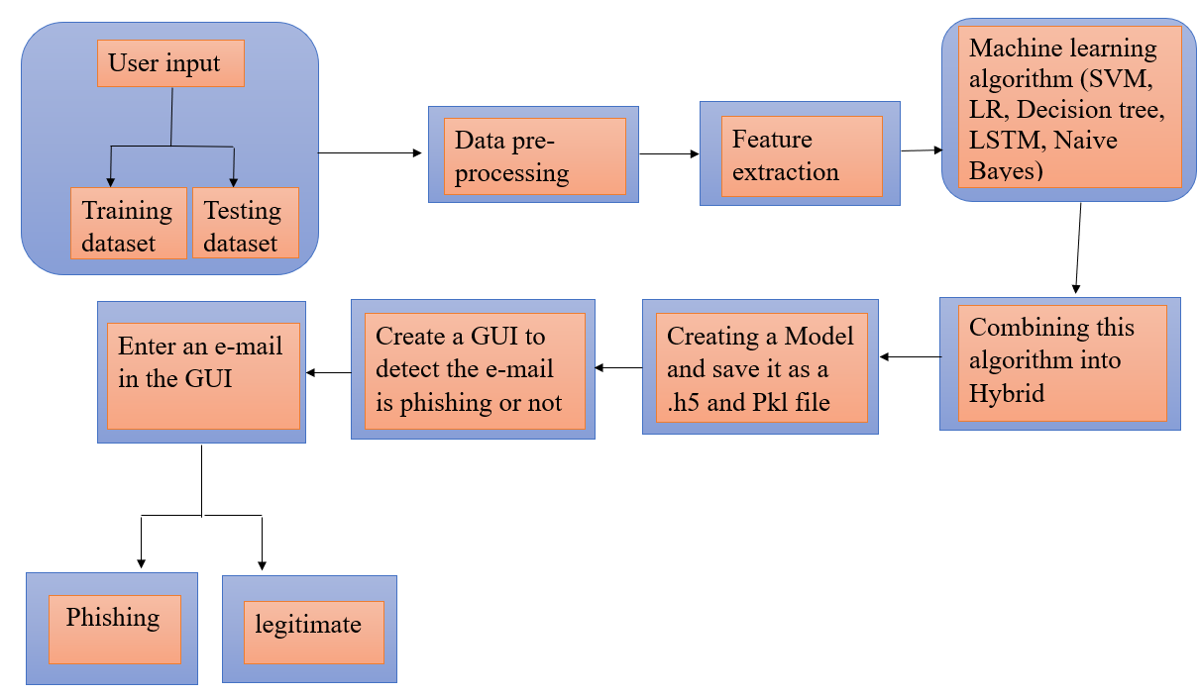
ARCHITECTURE DIAGRAM

Slide 5
MODULE DESCRIPTION
The data is collected and preprocessed in order to extract the key features that are crucial for training a model.
In order to distinguish legitimate emails from phishing emails, feature extraction is used to identify relevant attributes.
There are several machine learning algorithms that are trained on the dataset to recognize indications of phishing.
There are several metrics that are used to evaluate the performance of a model, including accuracy and precision.
An ensemble of models is combined, enhancing spear phishing detection, and a user-friendly GUI is developed for identifying spear phishing or not .

Slide 6
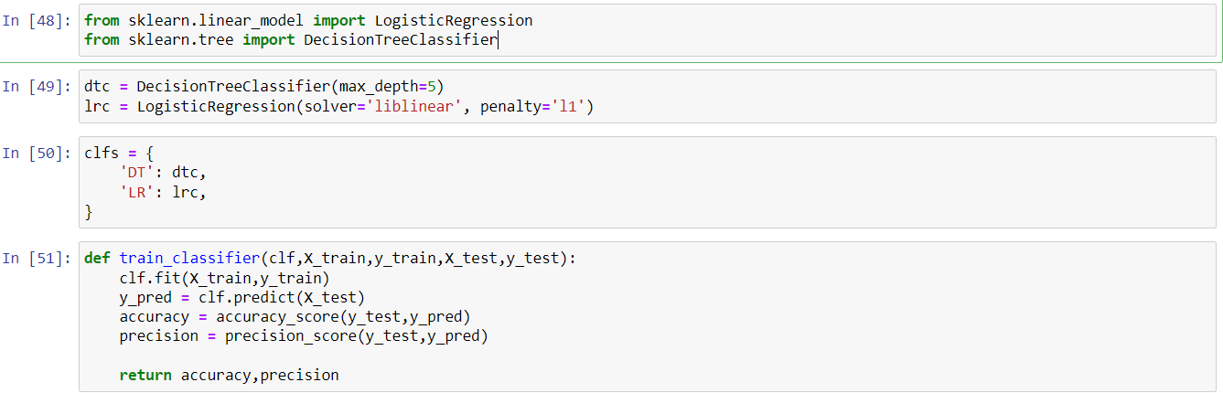
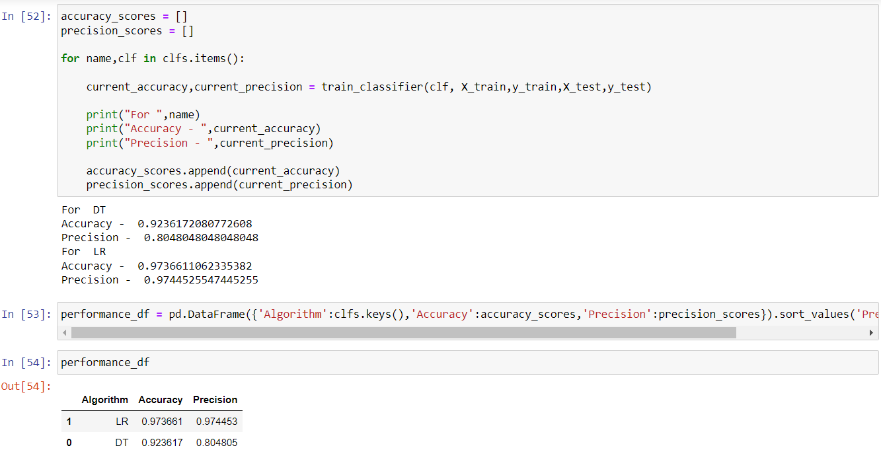
SAMPLE CODE
Spear phishing using DL and LR. Jpynb

Slide 7
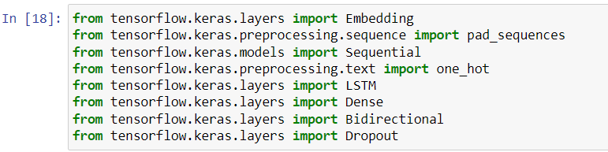
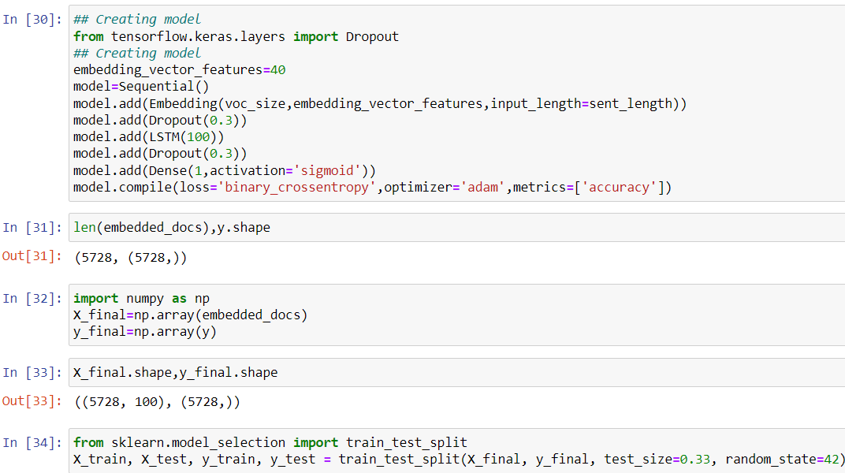
Spear_Email_LSTM.jpynb

Slide 8
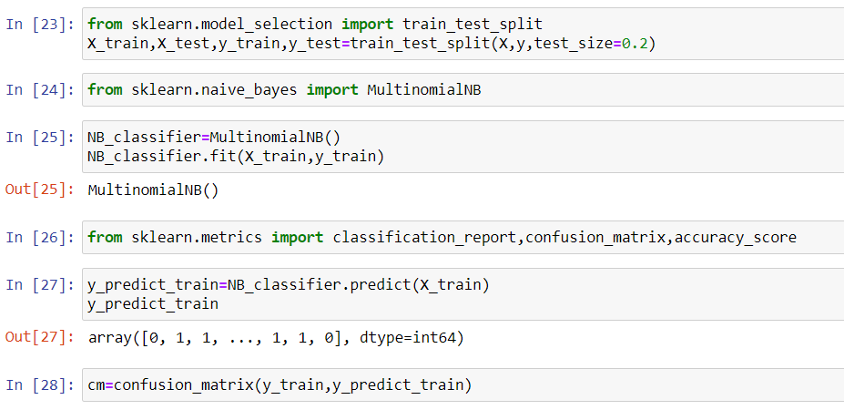
Spear_Email_Naive Bayes.jpynb

Slide 9
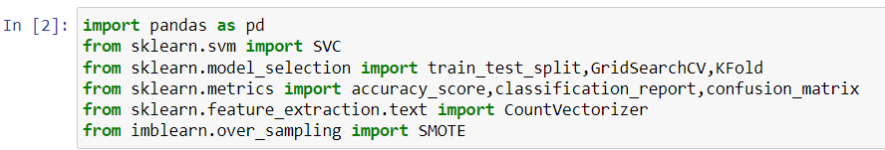
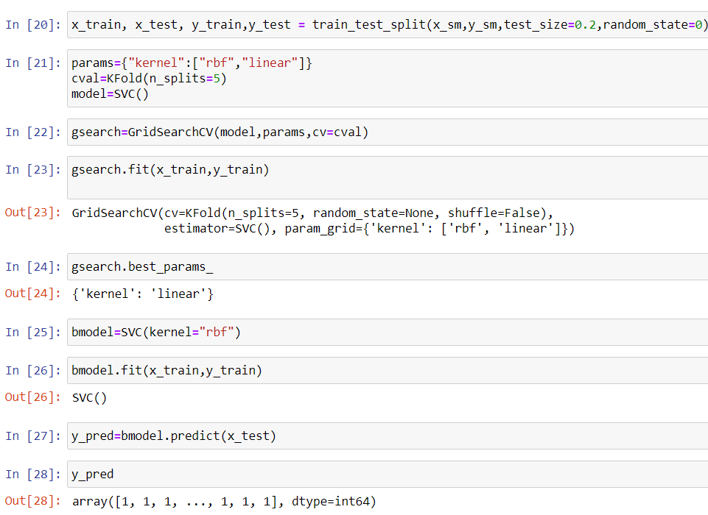
Spear_Email_SVM.jpynb

Slide 10
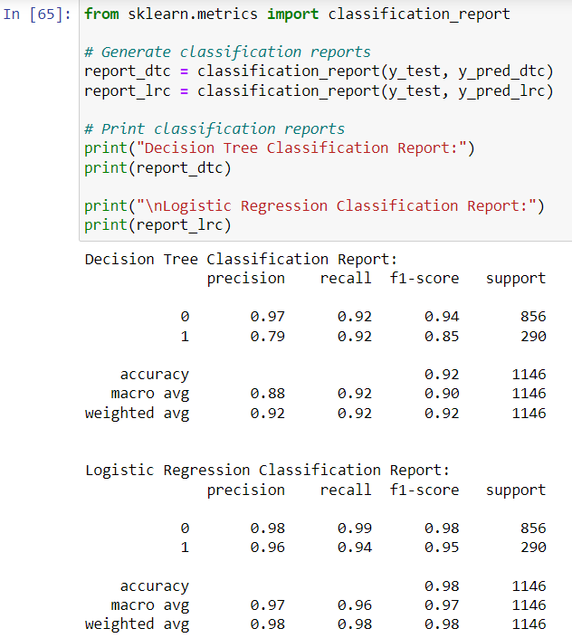
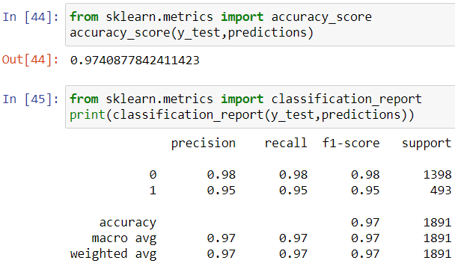
SAMPLE OUTPUT

Slide 11
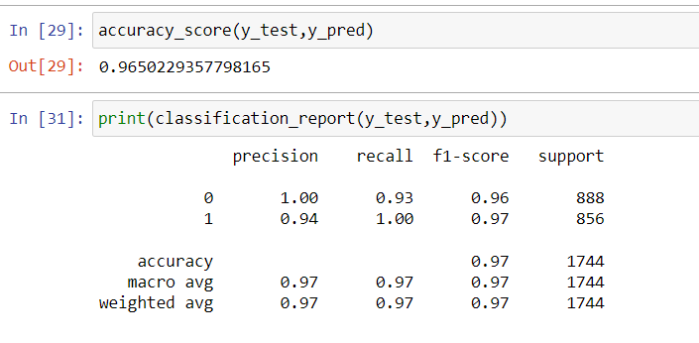
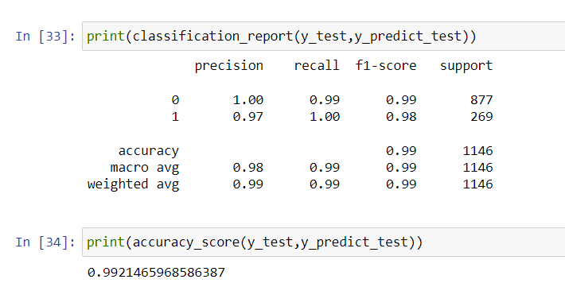

Slide 12
CONCLUSION
As a result, identifying spear phishing emails within organizations is crucial for maintaining cybersecurity integrity.
By utilizing machine learning techniques, such as LSTMs, decision trees, and logistic regression, SVM, Naïve Bayes algorithms, significant progress has been made in effectively distinguishing legitimate emails from spear phishing emails.
Using these algorithms to strengthen email security measures is demonstrated in this study. These results show impressive accuracy of 97%, 92%, 98%, 97%, 99%.

Slide 13
Thank You

